Slide 1
Alibi Generation
Christine Talbot
December 6, 2011

Slide 2
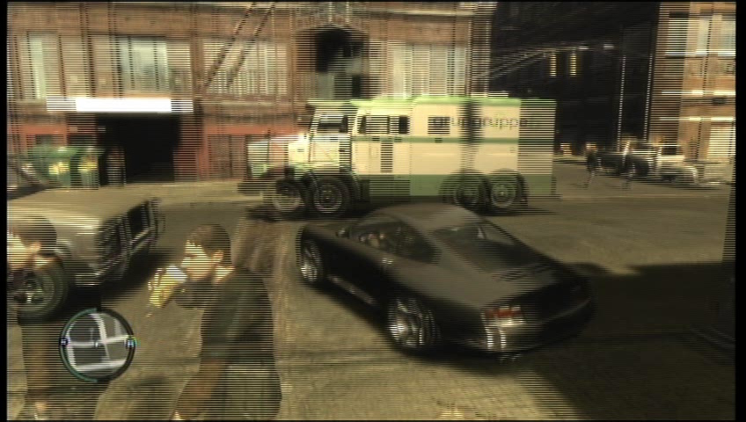
The Problem
From Ben Sunshine-Hill’s
AI Summit 2010 Presentation
Notes:
GTA4 video of pursuit of armored car
Expectation is that it would stop to drop off or pick up money, and at that time become vulnerable.
However, never did, which made the AI start to look stupid.
Concept is to utilize some heuristic to determine when the AI is being noticed, followed, etc and at that time apply more detailed goals that don’t appear as “stupid”, while minimizing the amount of processing required to do so

Slide 3
Goals of Method
Realistic AI characters
Fast calculations
Limited saved data
Notes:
Very realistic usually means slow and/or lots of data to carry around to be realistic
Must not be able to determine which characters are full or limited realism after long-term observation by player

Slide 4

How it Works
Area
World Map
Behavior Model
Character Generation
Position
Direction
Alibi
Position
Direction
Alibi Generation
Recycle
Current Goal
Long-term Plan
Home
Adapted from Ben Sunshine-Hill’s
AI Summit 2010 Presentation
Notes:
Talk about not knowing when a character will be important
Generate Alibi when having no goals or backstory is good enough, ex:
Choose turning direction / replanning
Player asks character name
Character in direct view long enough
Player starts to follow character
Will discard / recycle character if no longer in the “simulation bubble”

Slide 5
How Do We Determine an Alibi?
Offline:
Run a full simulation of all AI characters for some period of time
Save the probabilities that describe the relationships between different goals/goal types
Runtime:
Generate initial agents
Pick first goal at random
Use saved probabilities to influence random behaviors

Slide 6
Additional Details
Save probability table for transitioning from one location type to another
Apply that table when a decision is needed
Keep prior state information when doing a round-trip
Use bounded goals for home, work, etc. as needed
My home vs. a home
Use a specific goal as appropriate
A restaurant vs. a good restaurant
Stay for a random amount of time based on saved probabilities
Notes:
Uses semi-markov model which utilizes probs for state transitions and uses a distribution for time between transitions
Metropolis-Hastings algorithm for choosing goals using the predefined probabilities
A* for shortest paths to help with closest and paths to take
Only stores O(s+m2+m*n) ->s=segments, m=target types, n=targets
A lot more items in the real model, but showing just the examples of the states we’ve been discussing
Markov because dependent on prior state and uses transition probabilities
Only semi-markov because the transitions are not of unit time – it takes a distribution of time for the agent to make the transition
Look at specific example, see states of staying in a place, as well as walking from one place to another.
These can be broken down into the segments within the world that the agent travels over, which can repeat due to the different reasons the agent travels across them.

Slide 7

Example
From Ben Sunshine-Hill’s
AI Summit 2010 Presentation
John Q. Agent leaves home (“Home.883”) and goes to his workplace (“Work.231”).
He stays at work for several hours, then starts a round trip to the nearest restaurant (“Restaurant.22”).
After about half an hour, he returns to Work.231.
After several more hours, he goes back home to Home.883.
After a little while, he goes to visit his friend at Home.2141.

Slide 8
Demo Setup
Rooms are organized by type (classroom, lab, closet, etc.)
Building is broken up into waypoints with portals between them
Table of pre-defined probabilities for goals based on prior visited room’s type
Agent stays inside room for a varying period of time after arriving
Alibi is generated upon being visible by player
Player is moveable within simulation

Slide 9
Demo
Demo Website

Slide 10
Questions?
Christine Talbot
ctalbot1@uncc.edu

